Slide 1

JAVA
Data Type, Modifiers

Slide 2
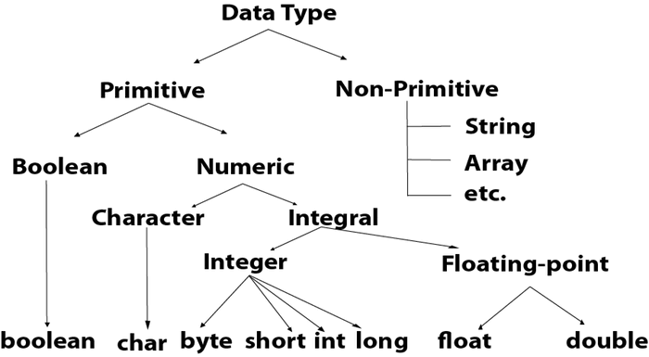
Data Type
Java language strongly typed programming language because the following reason
In java every variable and every expression has some type
Every data type clearly define
Every assignment should be checked by compiler for type compatibility

Slide 3
Data Type | Size | Description
byte | 1 byte | Stores whole numbers from -128 to 127
short | 2 bytes | Stores whole numbers from -32,768 to 32,767
int | 4 bytes | Stores whole numbers from -2,147,483,648 to 2,147,483,647
long | 8 bytes | Stores whole numbers from -9,223,372,036,854,775,808 to 9,223,372,036,854,775,807
float | 4 bytes | Stores fractional numbers. Sufficient for storing 6 to 7 decimal digits
double | 8 bytes | Stores fractional numbers. Sufficient for storing 15 decimal digits
boolean | 1 bit | Stores true or false values
char | 2 bytes | Stores a single character/letter or ASCII values
Primitive Data Type
In Java, we have eight primitive data types
byte, short, int and long data types are used for storing whole numbers.
float and double are used for fractional numbers.
char is used for storing characters(letters).
boolean data type is used for variables that holds either true or false

Slide 4
Non-Primitive Data Type
Arrays and Strings
The main difference between primitive and non-primitive data types are:
Primitive types are predefined (already defined) in Java. Non-primitive types are created by the programmer and is not defined by Java(Except for String)
Non-primitive types can be used to call methods to perform certain operations, while primitive types cannot.
A primitive type has always a value, while non-primitive types can be null
A primitive type starts with a lowercase letter, while non-primitive types starts with an uppercase letter
The size of a primitive type depends on the data type, while non-primitive types have all the same size.

Slide 5
Access Modifier
In old language like C++ public, private, protected, default are considered as Access Specifiers Expect this the remaining like static etc. are considered as Access Modifiers
But in JAVA there is no terminology like specifiers all are by default considered as modifiers only
Private
The access modifiers in Java specifies the accessibility or scope of a field, method, constructor, or class.
We can change the access level of fields, constructors, methods, and class by applying the access modifier on it
.
Public
The access level of a public modifier is everywhere. It can be accessed from within the class,
outside the class, within the package and outside the package.
Protected
The access level of a protected modifier is within the package and outside the package through child class.
If you do not make the child class, it cannot be accessed from outside the package.
Default
The access level of a default modifier is only within the package. It cannot be accessed from outside the package
If you do not specify any access level, it will be the default.

Slide 6
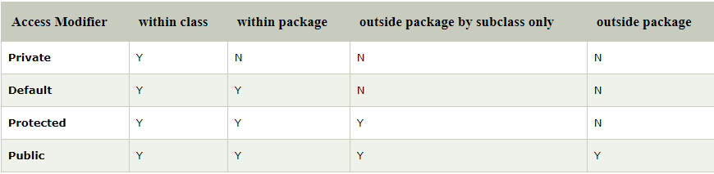
Access Level
The access level of a default modifier is only within the package. It cannot be accessed from outside the package. If you do not specify any access level, it will be the default.

Slide 7
Modifiers | Class |  | Method | Veriable | Blocks | Interface |  | Enum |  | Constructor
 | Inner | Outer |  |  |  | Inner | outer | inner | Outer
Public | ü | ü | ü | ü |  | ü | ü | ü | ü | ü
Private | ü |  | ü | ü |  | ü |  | ü |  | ü
Protected | ü |  | ü | ü |  | ü |  | ü |  | ü
Default | ü | ü | ü | ü |  | ü | ü | ü | ü | ü
final | ü | ü | ü | ü
abstract | ü | ü | ü |  |  | ü | ü
static | ü |  | ü | ü | ü | ü |  | ü
synchronized |  |  | ü |  | ü
native |  |  | ü
strictfp | ü | ü | ü |  |  | ü | ü | ü | ü
transient |  |  |  | ü
volitile |  |  |  | ü

Slide 8
Important Conclusions
The modifiers which are applicable for inner classes but not for outer classes : private, protected, static
The modifiers which are applicable for classes but not for interface are final
The modifiers which are applicable for classes but not for Enums are final and abstract
The modifiers which are applicable only for methods and which we can’t use any ware else native
The only modifiers which are applicable for contractors are : public, private, protected, default
The only applicable modifier for local variable is final

Slide 9
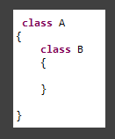
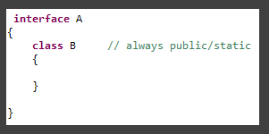
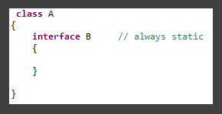
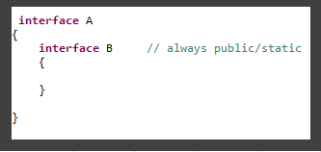
The class which is declared inside interface
is always public and static
The interface which is declared inside
a class is always static
The interface which is
declared inside interface
is always public

Slide 10
Not applicable modifiers with different level and with different modifiers
Methods | public | private
 |  | protected
 | abstact | final
 |  | static
 |  | synchronized
 |  | native
 |  | private
 |  | strictfp
Class | final | abstract
 | public | private
 |  | protected
Variable | public | private
 |  | protected
 | final | volitile

